Slide 1
Accounting Principles
Thirteenth Edition
Weygandt ● Kimmel ● Kieso
Chapter 13
Corporations: Organization and Capital Stock Transactions
This slide deck contains animations. Please disable animations if they cause issues with your device.

Slide 2
Chapter Outline
  Learning Objectives
L O 1 Discuss and major characteristics of a corporation.
L O 2 Explain how to account for common, preferred, and treasury stock.
L O 3 Prepare a stockholders’ equity section.

Slide 3
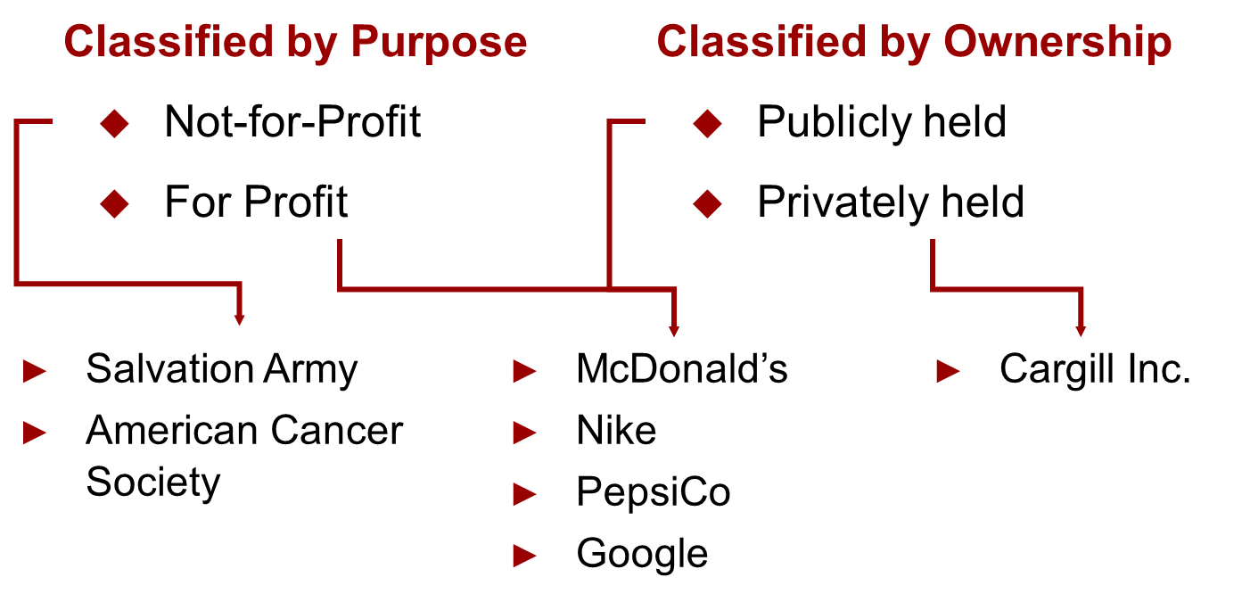
Corporate Form of Organization
An entity separate and distinct from its owners.

Slide 4
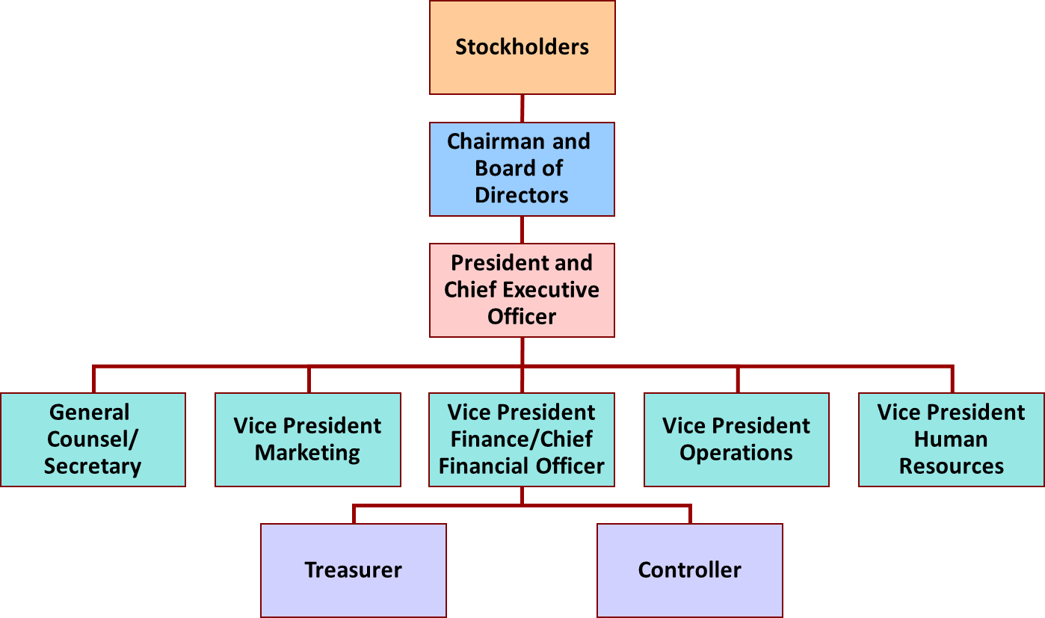
Characteristics of Corporation (1 of 4)

Slide 5
Characteristics of Corporation (2 of 4)
Characteristics that distinguish corporations from proprietorships and partnerships.
Advantages
Separate Legal Existence
Limited Liability of Stockholders
Transferable Ownership Rights
Ability to Acquire Capital
Continuous Life
Corporate Management
Disadvantages
Corporate Management
Government Regulations
Additional Taxes

Slide 6
Characteristics of Corporation (3 of 4)
Characteristics that distinguish corporations from proprietorships and partnerships.
Separate Legal Existence → Corporation acts under its own name rather than in the name of its stockholders.
Limited Liability of Stockholders → Limited to their investment.
Transferable Ownership → Stockholders may sell their stock.
Ability to Acquire Capital → Corporation can obtain capital through the issuance of stock.

Slide 7
Characteristics of Corporation (4 of 4)
Characteristics that distinguish corporations from proprietorships and partnerships.
Continuous Life → Continuance as a going concern is not affected by the withdrawal, death, or incapacity of a stockholder, employee, or officer.
Corporate Management → Separation of ownership and management often reduces an owner’s ability to actively manage the company.
Government Regulations → A corporation is subject to numerous state and federal regulations.
Additional Taxes → Corporations pay income taxes as a separate legal entity and in addition, stockholders pay taxes on cash dividends.

Slide 8
Forming a Corporation
Initial Steps:
File application with the Secretary of State
State grants charter
Corporation develops by-laws
Companies generally incorporate in a state whose laws are favorable to the corporate form of business.
Corporations engaged in interstate commerce must obtain a license from each state in which they do business.

Slide 9
Stockholder Rights
Vote in election of board of directors at annual meeting and vote on actions that require stockholder approval.
Share the corporate earnings through receipt of dividends.
Keep the same percentage ownership when new shares of stock are issued (preemptive right).
Share in assets upon liquidation in proportion to their holdings. This is called a residual claim.

Slide 10
Stock Issue Considerations (1 of 6)
When a corporation decides to issue stock, it must resolve a number of basic questions:
How many shares should it authorize for sale?
How should it issue the stock?
What value should the corporation assign to the stock?

Slide 11
Stock Issue Considerations (2 of 6)
Authorized Stock
Charter indicates amount of stock that a corporation is authorized to sell
Number of authorized shares is often reported in stockholders’ equity section
No formal accounting entry

Slide 12
Stock Issue Considerations (3 of 6)
Issuance of Stock
Companies issue common stock directly to investors or indirectly through an investment banking firm
Factors in setting price for a new issue of stock:
  Company’s anticipated future earnings
  Expected dividend rate per share
  Current financial position
  Current state of economy
  Current state of securities market

Slide 13
Do It! 1a: Corporate Organization (3 of 3)
Indicate whether each of the following statements is true or false. If false, indicate how to correct the statement.
4. The journal entry to record the authorization of capital stock includes a credit to the appropriate capital stock account.
False. The authorization of capital stock does not result in a formal accounting entry.
5. All states require a par value per share for capital stock.
False. Many states do not require a par value.

Slide 14
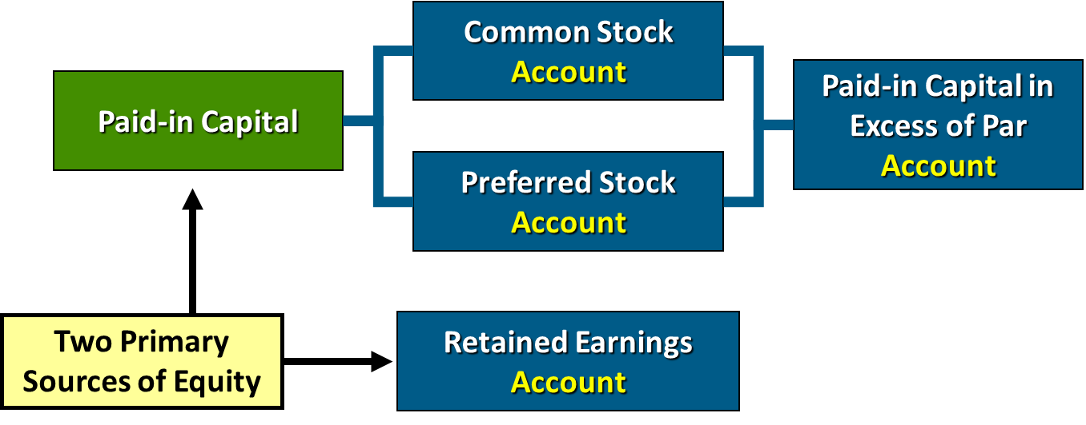
Corporate Capital (1 of 3)
Paid-in capital is the total amount of cash and other assets paid in to the corporation by stockholders in exchange for capital stock.

Slide 15
Corporate Capital (2 of 3)
Retained earnings is net income that a corporation retains for future use.

Slide 16
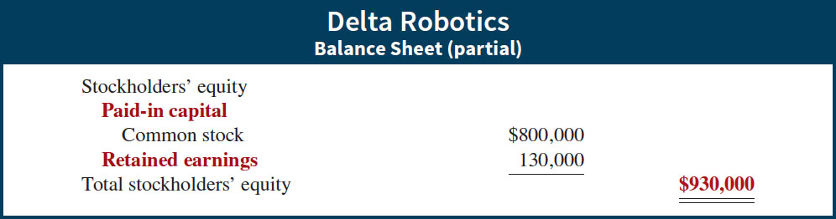
Retained Earnings
If Delta Robotics has a balance of $800,000 in common stock and $130,000 in retained earnings at the end of its first year, its stockholders’ equity section is as follows.

Slide 17
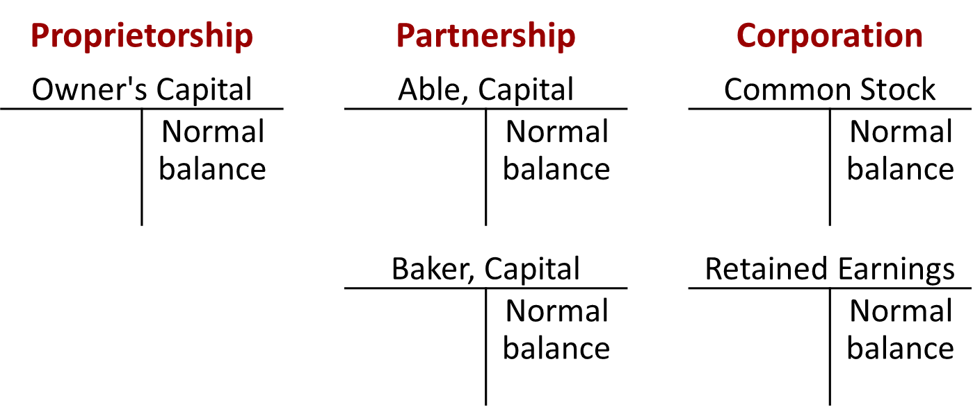
Corporate Capital (3 of 3)
Comparison of the owners’ equity (stockholders’ equity) accounts reported on a balance sheet.

Slide 18
Do It! 1b: Corporate Capital
Illustration: At the end of its first year of operation, Doral Corporation has $750,000 of common stock and net income of $122,000. Prepare (a) the closing entry for net income and (b) the stockholders’ equity section at year-end.
(a)
Income Summary
122,000
Retained Earnings
(To close Income Summary and transfer net income to Retained Earnings)
122,000
(b)
Stockholders’ equity
Paid-in capital
Common stock
$750,000
Retained earnings
Total stockholders’ equity

Slide 19
Accounting for Stock Transactions (1 of 2)
Accounting for Common Stock
Primary Objectives:
  Identify the specific sources of paid-in capital.
  Maintain the distinction between paid-in capital and retained earnings.
  Other than consideration received, the issuance of common stock affects only paid-in capital accounts.

Slide 20
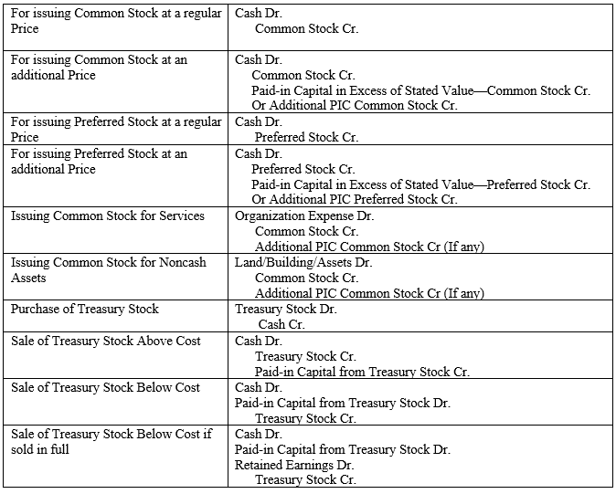
Share Issue Journals

Slide 21
Share Issue Journals
For issuing Common Stock at a regular Price | Cash Dr. Common Stock Cr.
For issuing Common Stock at an additional Price | Cash Dr. Common Stock Cr. Paid-in Capital in Excess of Stated Value—Common Stock Cr. Or Additional PIC Common Stock Cr.
For issuing Preferred Stock at a regular Price | Cash Dr. Preferred Stock Cr.
For issuing Preferred Stock at an additional Price | Cash Dr. Preferred Stock Cr. Paid-in Capital in Excess of Stated Value—Preferred Stock Cr. Or Additional PIC Preferred Stock Cr.
Issuing Common Stock for Services | Organization Expense Dr. Common Stock Cr. Additional PIC Common Stock Cr (If any)
Issuing Common Stock for Noncash Assets | Land/Building/Assets Dr. Common Stock Cr. Additional PIC Common Stock Cr (If any)
Purchase of Treasury Stock | Treasury Stock Dr. Cash Cr.
Sale of Treasury Stock Above Cost | Cash Dr. Treasury Stock Cr. Paid-in Capital from Treasury Stock Cr.
Sale of Treasury Stock Below Cost | Cash Dr. Paid-in Capital from Treasury Stock Dr. Treasury Stock Cr.
Sale of Treasury Stock Below Cost if sold in full | Cash Dr. Paid-in Capital from Treasury Stock Dr. Retained Earnings Dr. Treasury Stock Cr.

Slide 22
Issuing Common Stock for Cash (1 of 4)
Illustration: Assume that Hydro-Slide, Inc. issues 1,000 shares of $1 par value common stock. Prepare Hydro-Slide’s journal entry if (a) 1,000 share are issued for $1 per share, and (b) 1,000 shares are issued for $5 per share.
(a)
Cash
1,000
Common Stock (1,000 × $1)
(To record issuance of 1,000 shares of $1 par common stock at par)
1,000
(b)
Cash
5,000
Common Stock (1,000 × $1)
1,000
Paid-in Capital in Excess of Par—Common Stock
(To record issuance of 1,000 shares of $1 par common stock)
4,000

Slide 23
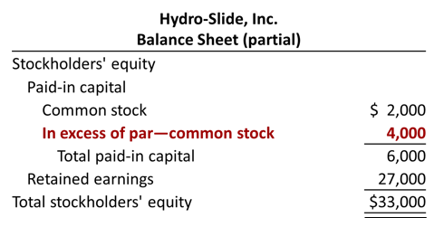
Accounting for Stock Transactions (2 of 4)

Slide 24
Issuing No-Par Common Stock for Cash (3 of 4)
Illustration: Assume that instead of $1 par value stock, Hydro-Slide, Inc. has $5 stated value no-par stock and the company issues 5,000 shares at $8 per share for cash.
Cash
40,000
Common Stock (5,000 × $5)
25,000
Paid-in Capital in Excess of Stated Value—Common Stock
(To record issue of 5,000 shares of $5 stated value no-par stock)
15,000

Slide 25
Issuing No-Par Common Stock for Cash (4 of 4)
Illustration: Assume further that the no-part stock does not have a stated value and the company issues 5,000 shares at $8 per share for cash.
Cash
40,000
Common Stock
(To record issue of 5,000 shares of no-par stock)
40,000

Slide 26
Issuing Common Stock for Services or Noncash Assets
Corporations also may issue stock for:
Services (attorneys or consultants)
Noncash assets (land, buildings, and equipment)
Cost is either the fair market value of the consideration given up, or the fair market value of the consideration received, whichever is more clearly determinable.

Slide 27
Common Stock for Services (1 of 2)
Illustration: Attorneys have helped Jordan Company incorporate. They have billed the company $5,000 for their services. They agree to accept 4,000 shares of $1 par value common stock in payment of their bill. At the time of the exchange, there is no established market price for the stock. Prepare the journal entry for this transaction.
Organizational Expense
5,000
Common Stock (4,000 × $1)
4,000
Paid-in Capital in Excess of Par Value—Common Stock
(To record issuance of 4,000 shares of $1 par value stock to attorneys)
1,000

Slide 28
Common Stock for Services (2 of 2)
Illustration: Athletic Research Inc. is an existing publicly held corporation. Its $5 par value stock is actively traded at $8 per share. The company issues 10,000 shares of stock to acquire land recently advertised for sale at $90,000. Prepare the journal entry for this transaction.
Land
80,000
Common Stock (10,000 × $5)
50,000
Paid-in Capital in Excess of Par Value—Common Stock
(To record issuance of 10,000 shares of $5 par value stock for land)
30,000

Slide 29
Accounting for Preferred Stock (1 of 2)
Typically, preferred stockholders have a priority as to:
Distributions of earnings (dividends).
Assets in event of liquidation.
Generally do not have voting rights.
Accounting for preferred stock at issuance is similar to that for common stock.

Slide 30
Accounting for Preferred Stock (2 of 2)
Illustration: Stine Corporation issues 10,000 shares of $10 par value preferred stock for $12 cash per share. The journal entry to record the issuance is:
Cash
120,000
Preferred Stock (10,000 × $10)
100,000
Paid-in Capital in Excess of Par Value—Preferred Stock
(To record the issuance of 10,000 shares of $10 par value preferred stock)
20,000
Preferred stock may have a par value or no-par value.

Slide 31
Do It! 2a: Issuance of Stock (1 of 3)
Illustration: Cayman Corporation begins operations on March 1 by issuing 100,000 shares of $1 par value common stock for cash at $12 per share. Journalize the issuance of the common shares on March 1 assuming the shares are not publicly traded.
Cash
1,200,000
Common Stock (100,000 × $1)
100,000
Paid-in Capital in Excess of Par Value—Common Stock
(To record issuance of 100,000 shares at $12 per share)
1,100,000

Slide 32
Do It! 2a: Issuance of Stock (2 of 3)
Illustration: On March 15, Cayman issues 5,000 shares of common stock to attorneys in settlement of their bill of $50,000 for organization costs. Journalize the issuance of these shares.
Organization Expense
50,000
Common Stock (5,000 × $1)
5,000
Paid-in Capital in Excess of Par Value—Common Stock
(To record issuance of 5,000 shares for attorneys’ fees)
45,000

Slide 33
Do It! 2a: Issuance of Stock (3 of 3)
Illustration: On March 28, Cayman issues 1,500 shares of $10 par value preferred stock for cash at $30 per share. Journalize the issuance of preferred shares.
Cash
45,000
Preferred Stock (1,500 × $10)
15,000
Paid-in Capital in Excess of Par Value—Preferred Stock
(To record issuance of 1,500 shares at $30 per share)
30,000

Slide 34
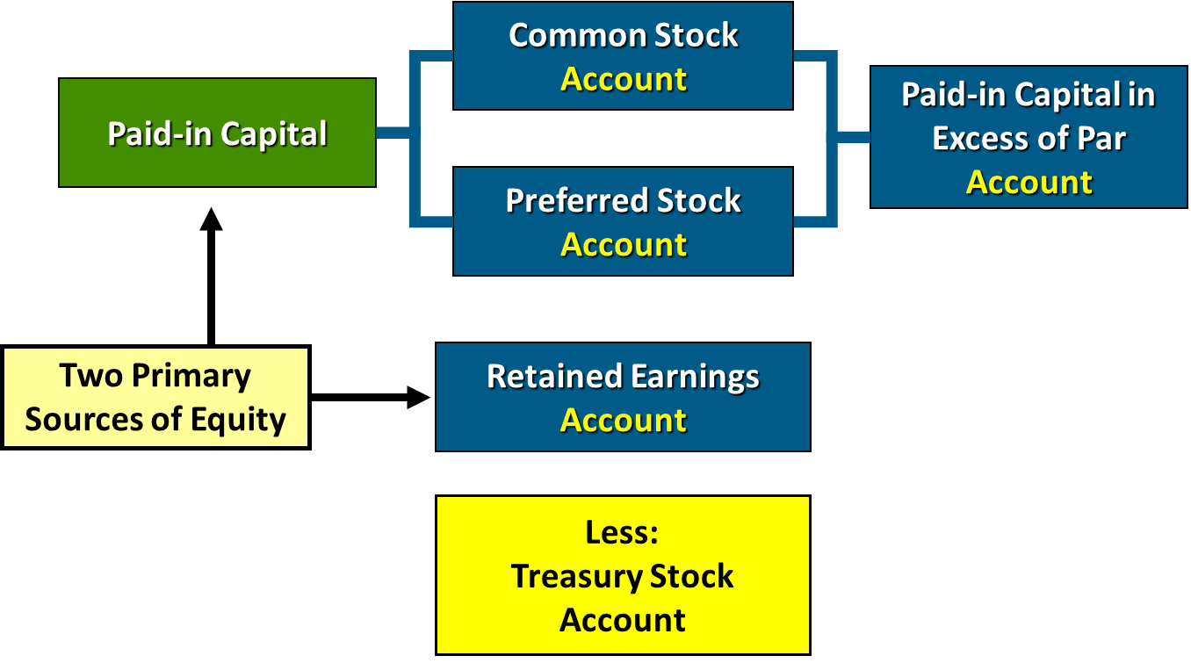
Accounting for Treasury Stock (1 of 5)

Slide 35
Accounting for Treasury Stock (2 of 5)
Treasury stock is a corporation’s own stock that it has issued and subsequently reacquired from shareholders but not retired.
Corporations acquire treasury stock for various reasons:
  To reissue the shares to officers and employees under bonus and stock compensation plans.
  To enhance the stock’s market value.
  To have additional shares available for use in the acquisition of other companies.
  To increase earnings per share.

Slide 36
Accounting for Treasury Stock (3 of 5)
Companies generally use cost method
Debit Treasury Stock for price paid to reacquire shares
Treasury stock is a contra stockholders’ equity account
Reduces stockholders’ equity

Slide 37
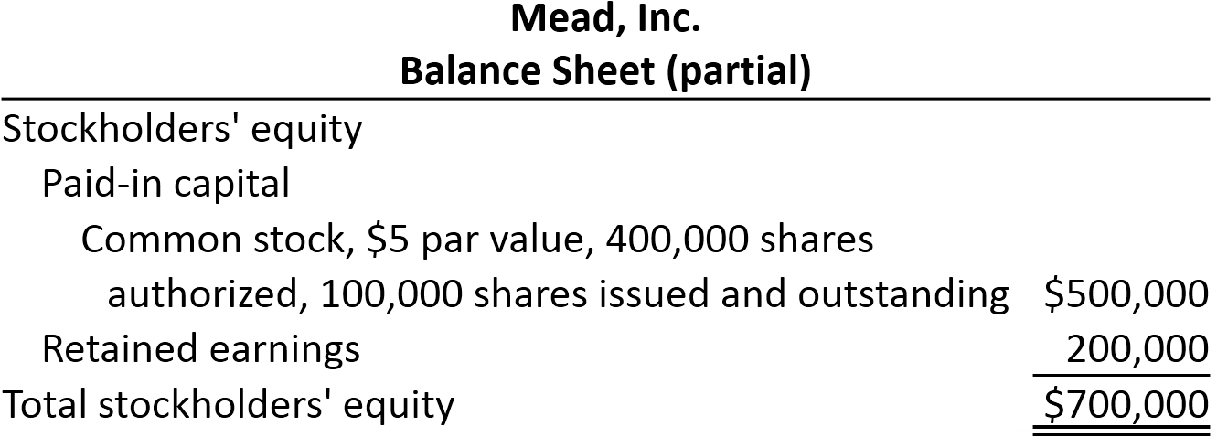
Accounting for Treasury Stock (4 of 5)
Illustration: On February 1, 2020, Mead acquires 4,000 shares of its stock at $8 per share. The entry is as follows.
Feb. 1 Treasury Stock (4,000 × $8)
32,000
Cash
(To record purchase of 4,000 shares of treasury stock at $8 per share)
32,000

Slide 38
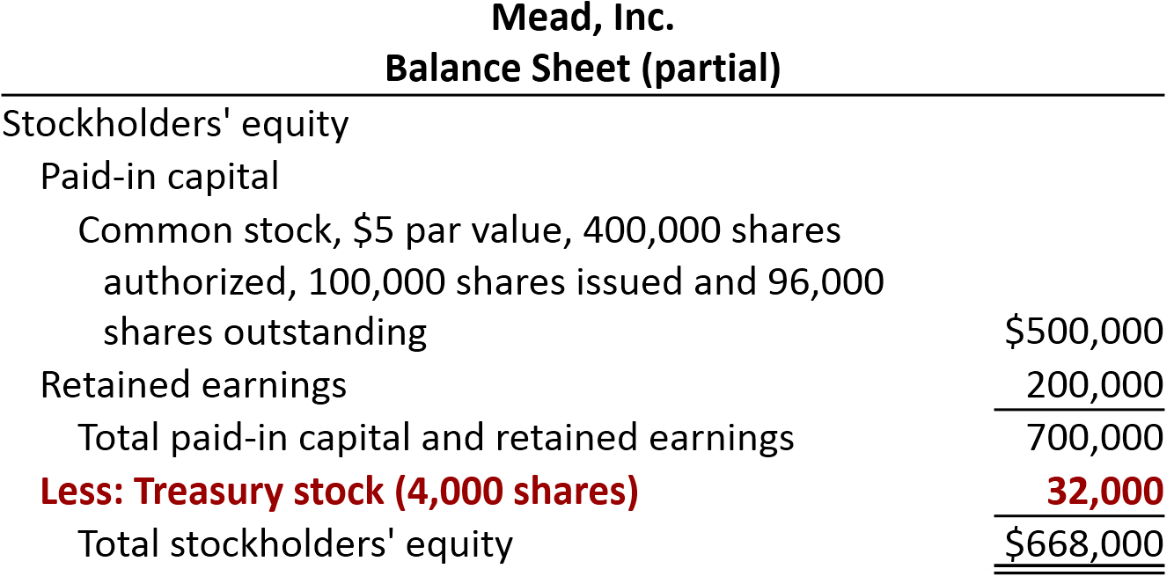
Accounting for Treasury Stock (5 of 5)
Both the number of shares issued (100,000) and the number of shares held as treasury (4,000) are disclosed.

Slide 39
Sale of Treasury Stock Above Cost
Illustration: On July 1, Mead, Inc. sells for $10 per share 1,000 of the 4,000 shares of its treasury stock previously acquired at $8 per share. The entry is as follows.
Jul. 1 Cash
10,000
Treasury Stock (1,000 × $8)
8,000
Paid-in Capital from Treasury Stock
(To record sale of 1,000 shares of treasury stock above cost)
2,000
A corporation does not realize a gain or suffer a loss from stock transactions with its own stockholders.

Slide 40
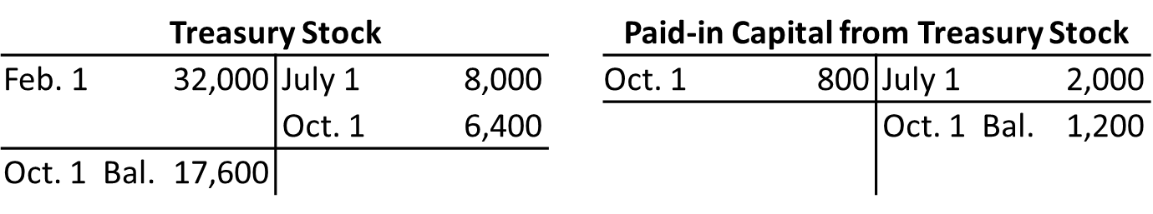
Sale of Treasury Stock Below Cost (1 of 2)
If Mead, Inc. sells an additional 800 shares of treasury stock on October 1 at $7 per share, it makes the following entry.
Cash (800 × $7)
5,600
Paid-in Capital from Treasury Stock
800
Treasury Stock (800 × $8)
(To record sale of 800 shares of treasury stock below cost)
6,400

Slide 41
Sale of Treasury Stock Below Cost (2 of 2)
On December 1, assume that Mead, Inc. sells its remaining 2,200 shares at $7 per share and makes the following entry.
Cash (2,200 × $7)
15,400
Limited to balance on hand
Paid-in Capital from Treasury Stock
1,200
Retained Earnings
1,000
Treasury Stock (2,200 × $8)
(To record sale of 2,200 shares of treasury stock at $7 per share)
17,600

Slide 42
Do It! 2b: Treasury Stock
Santa Anita Inc. purchases 3,000 shares of its $50 par value common stock for $180,000 cash on July 1. It will hold the shares in the treasury until resold. On November 1, the corporation sells 1,000 shares of treasury stock for cash at $70 per share. Journalize the treasury stock transactions.
July 1
Treasury Stock
180,000
Cash
(To record the purchase of 3,000 shares at $60 per share)
180,000
Nov. 1
Cash
70,000
Treasury Stock
60,000
Paid-in Capital from Treasury Stock
(To record the sale of 1,000 shares at $70 per share)
10,000

Slide 43
Explain the Accounting and Reporting Issues Related to Dividends

Slide 44
Dividend Policy
Few companies pay dividends in amounts equal to their legally available retained earnings. Why?
Maintain agreements with creditors.
Meet state incorporation requirements.
To finance growth or expansion.
To smooth out dividend payments.
To build up a cushion against possible losses.
  LO 3

Slide 45
Dividend Policy
Financial Condition and Dividend Distributions
A company should not pay a dividend unless both the present and future financial position warrant the distribution.
The S E C encourages companies to disclose their dividend policy in their annual report, especially those that
have earnings but fail to pay dividends, or
do not expect to pay dividends in the foreseeable future.
The S E C encourages companies that consistently pay dividends to indicate whether they intend to continue this practice in the future.
  LO 3

Slide 46
Dividend Journal
Dividends Declaration Record Date | Retained Earnings Dr. Dividend Payable Cr.
Dividends Declaration Payment Date | Dividend Payable Dr. Cash Cr.
Property Dividends (At date of declaration) | Equity Investments Dr. Unrealized Holding Gain or Loss-income Dr. Retained Earnings Dr. Property Dividend Payable Cr.
Property Dividends (At date of distribution) | Property Dividend Payable Dr. Equity Investments Cr.
Liquidating Dividends (At date of declaration) | Retained Earnings Dr. Additional PIC Common Stock Dividend Payable Cr.
Liquidating Dividends (At date of distribution) | Dividend Payable Dr. Cash Cr.
Stock Dividend (At date of declaration) | Retained Earnings Dr. Common Stock Dividend Distributable Cr. APIC Common Stock Cr.
Stock Dividend (At date of distribution) | Common Stock Dividend Distributable Dr. Common Stock Cr.

Slide 47
Dividend Policy
Types of Dividends
Cash dividends.
Property dividends (dividends in kind).
Liquidating dividends.
All dividends, except for stock dividends, reduce the total stockholders’ equity in the corporation.
  LO 3

Slide 48
Types of Dividends
Cash Dividends
Board of directors vote on the declaration of cash dividends.
A declared cash dividend is a liability.
Companies do not declare or pay cash dividends on treasury stock.
Three dates:
a. Date of declaration
b. Date of record
c. Date of payment
  LO 3

Slide 49
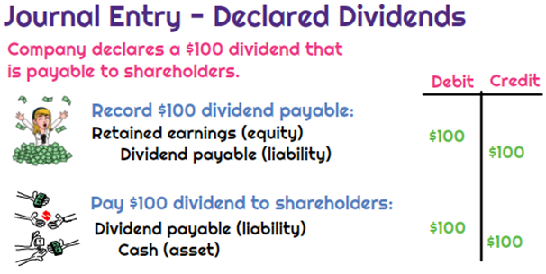
Cash Dividends

Slide 50
Types of Dividends
Property Dividends
Dividends payable in assets other than cash.
Restate at fair value the property it will distribute, recognizing any gain or loss.
  LO 3

Slide 51
Property Dividends
Illustration: Trendler, Inc. transferred to stockholders some of its equity investments costing $1,250,000 by declaring a property dividend on December 28, 2019, to be distributed on January 30, 2020, to stockholders of record on January 15, 2020. At the date of declaration, the securities have a market value of $2,000,000. Trendler makes the following entries.
At date of declaration (December 28, 2019)
Equity Investments
750,000
Unrealized Holding Gain or Loss—Income
750,000
Retained Earnings
2,000,000
Property Dividends Payable
2,000,000
  LO 3

Slide 52
Property Dividends
Date of Distribution
Illustration: Trendler, Inc. transferred to stockholders some of its equity investments costing $1,250,000 by declaring a property dividend on December 28, 2019, to be distributed on January 30, 2020, to stockholders of record on January 15, 2020. At the date of declaration, the securities have a market value of $2,000,000. Trendler makes the following entries.
At date of distribution (January 30, 2020)
Property Dividends Payable
2,000,000
Equity Investments
2,000,000
  LO 3

Slide 53
Types of Dividends
Liquidating Dividends
Any dividend not based on earnings reduces corporate paid-in capital.
The portion of these dividends in excess of accumulated income represents a return of part of the stockholder’s investment.
  LO 3

Slide 54
Liquidating Dividends
Illustration: McChesney Mines, Inc. issued a “dividend” to its common stockholders of $1,200,000. The announcement noted stockholders should consider $900,000 as income and the remainder a return of capital. McChesney Mines records the dividend as follows.
At date of declaration
Retained Earnings
900,000
Paid-in Capital in Excess of Par—Common
300,000
Dividends Payable
1,200,000
At date of payment
Dividends Payable
1,200,000
Cash
1,200,000
  LO 3

Slide 55
Stock Dividends and Stock Splits
Stock Dividends
Issuance by a company of its own stock to stockholders on a pro rata basis, without receiving any consideration.
Used when management wishes to “capitalize” part of earnings.
If stock dividend is less than 20 to 25 percent of the common shares outstanding, company transfers fair market value from retained earnings (small stock dividend).
  LO 3

Slide 56
Stock Dividends
Illustration: Vine Corporation has outstanding 1,000 shares of $100 par value common stock and retained earnings of $50,000. If Vine declares a 10 percent stock dividend, it issues 100 additional shares to current stockholders. If the fair value of the stock at the time of the stock dividend is $130 per share, the entry is:
At date of declaration
Retained Earnings
13,000
Common Stock Dividend Distributable
10,000
Paid-in Capital in Excess of Par—Common
3,000
At date of distribution
Common Stock Dividend Distributable
10,000
Common Stock
10,000
  LO 3

Slide 57
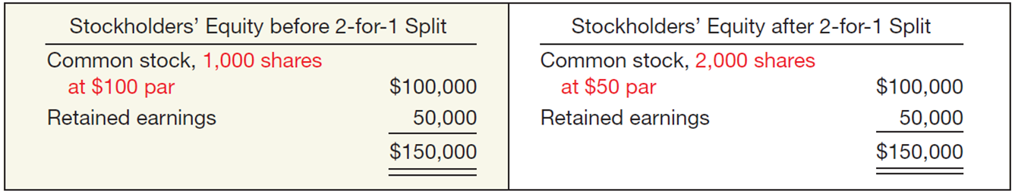
Dividend Policy
Stock Splits: In the case of a stock split, each old share is split into a number of new shares with a reduced par value, leaving the total share capital unchanged. In the case of a stock dividend, a number of new shares are received for each share owned.
To reduce the market value of shares.
No entry recorded for a stock split.
Decrease par value and increase number of shares.
  LO 3

Slide 58
Dividend Policy
Stock Split and Stock Dividend Differentiated
Large Stock Dividend – more than 20 to 25 percent of the number of shares previously outstanding.
Same effect on market price as a stock split.
Par value transferred from retained earnings to capital stock.
  LO 3

Slide 59
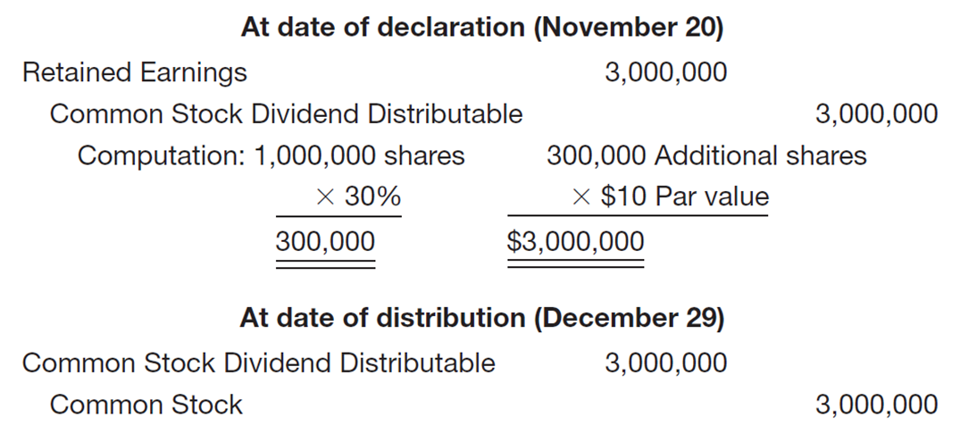
Stock Dividend Entries
Illustration: Rockland Steel, Inc. declared a 30 percent share dividend on November 20, payable December 29 to stockholders of record December 12. At the date of declaration, 1,000,000 shares, par value $10, are outstanding and with a fair value of $200 per share. The entries are:
  LO 3

Slide 60
Statement Presentation of Stockholders’ Equity (1 of 2)
Companies report paid-in capital and retained earnings in the stockholders’ equity section of the balance sheet. Paid-in capital includes:
Capital stock. Preferred stock appears before common stock because of its preferential rights. Companies report par value, shares authorized, shares issued, and shares outstanding for each class of stock.
Additional paid-in capital. Excess amounts paid in over par or stated value and paid-in capital from treasury stock.

Slide 61
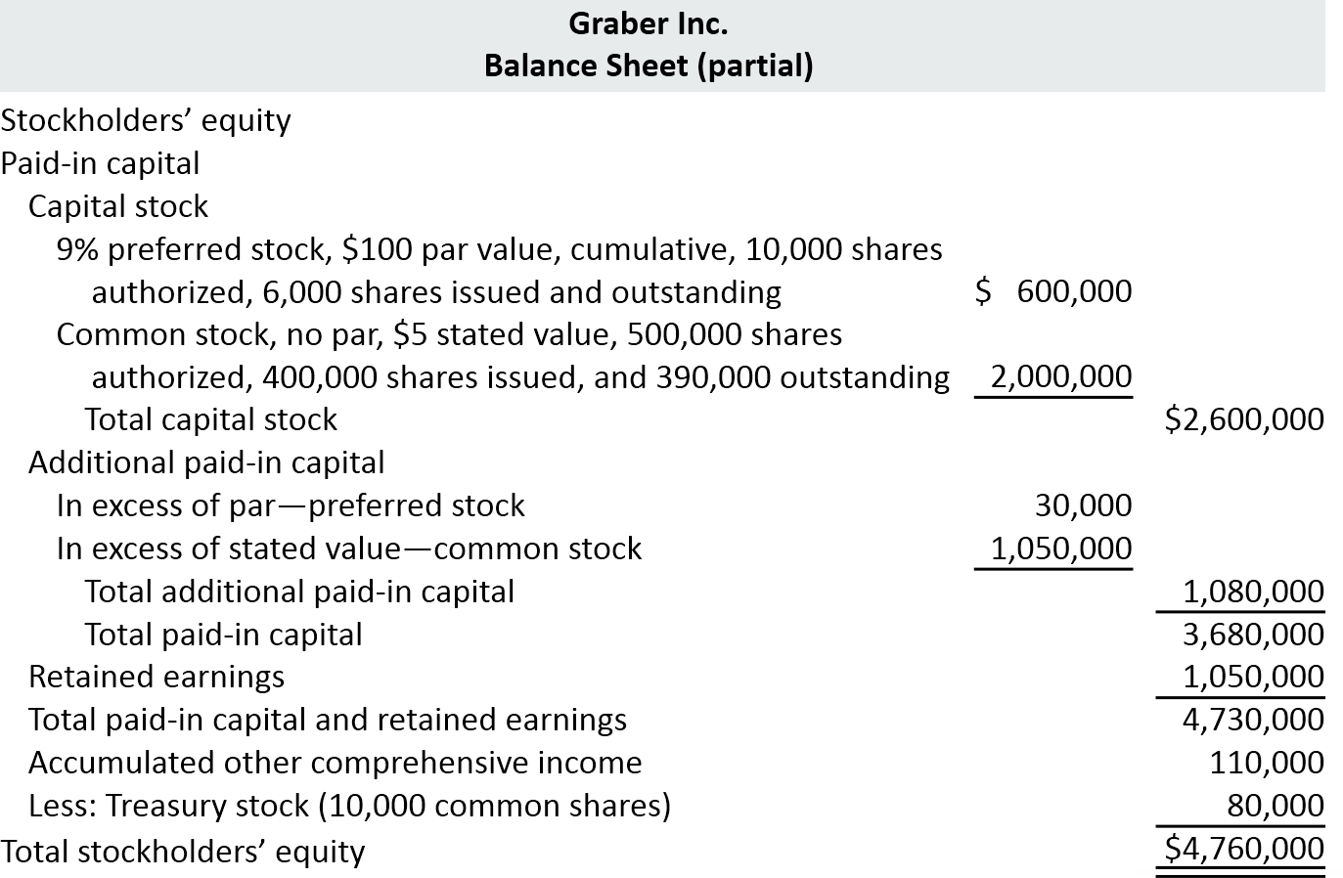
Statement Presentation of Stockholders’ Equity (2 of 2)

Slide 62
Do It! 3: Stockholders’ Equity (1 of 2)
Jennifer Corporation has issued 300,000 shares of $3 par value common stock. It is authorized to issue 600,000 shares. The paid-in capital in excess of par value on the common stock is $380,000. The corporation has reacquired 15,000 shares at a cost of $50,000 and is currently holding those shares. It also had a cumulative other comprehensive loss of $82,000. The corporation also has 4,000 shares issued and outstanding of 8%, $100 par value preferred stock. It is authorized to issue 10,000 shares. The paid-in capital in excess of par value on the preferred stock is $97,000. Retained earnings is $610,000.
Prepare the stockholders’ equity section of the balance sheet.

Slide 63
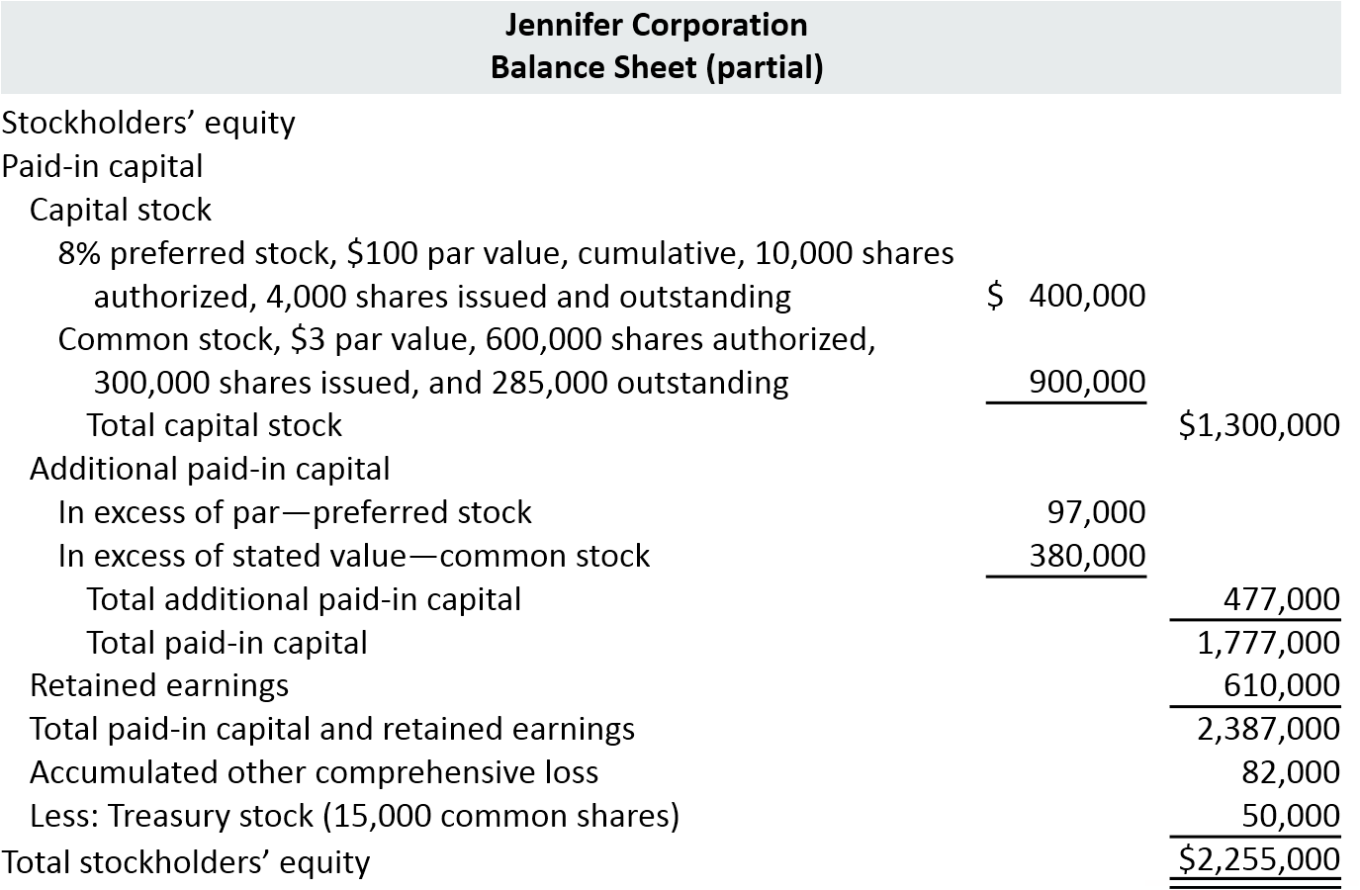
Do It! 3: Stockholders’ Equity (2 of 2)

Slide 64
Analysis of Stockholders’ Equity (1 of 2)
  Payout Ratio
  Measures percentage of earnings a company distributes in form of cash dividends to common stockholders
To illustrate, Nike’s dividends were recently $821 million and net income was $2,693 million.
$821 ÷ $2,693 = 30.5%

Slide 65
Analysis
Payout Ratio
Illustration: Troy Co. has cash dividends of $100,000 and net income of $500,000, and no preferred stock outstanding.
  LO 4

Slide 66
Analysis of Stockholders’ Equity (2 of 2)
  Return on Common Stockholders’ Equity
  Indicates how many dollars of net income company earned for each dollar invested by common stockholders
  Walt Disney Company’s beginning and ending common stockholders’ equity were $31,820 and $30,753 million, respectively. Net income was $4,687 million, no preferred stock.

Slide 67
Analysis
Rate of Return on Common Stockholders’ Equity
Illustration: Gerbers Inc. had net income of $360,000, declared and paid preferred dividends of $54,000, and average common stockholders’ equity of $2,550,000.
  LO 4

Slide 68
Do It! 2: Analyzing Stockholders’ Equity (1 of 3)
On January 1, 2020, Siena Corporation purchased 2,000 shares of treasury stock. Other information regarding Siena Corporation is provided below.
 | 2019 | 2020
Net income | $110,000 | $110,000
Dividends on preferred stock | 10,000 | 10,000
Dividends on common stock | 2,000 | 1,600
Common stockholders’ equity, beginning of year | 500,000 | 400,000*
Common stockholders’ equity, ending of year | 500,000 | 400,000
*Adjusted for purchase of treasury stock.
(a) Compute return on common stockholders’ equity for each year, and (b) discuss its change from 2019 to 2020.

Slide 69
Do It! 2: Analyzing Stockholders’ Equity (2 of 3)
 | 2019 | 2020
Net income | $110,000 | $110,000
Dividends on preferred stock | 10,000 | 10,000
Dividends on common stock | 2,000 | 1,600
Common stockholders’ equity, beginning of year | 500,000 | 400,000*
Common stockholders’ equity, ending of year | 500,000 | 400,000
*Adjusted for purchase of treasury stock.
(a) Compute return on common stockholders’ equity for each year.
2019
2020

Slide 70
Do It! 2: Analyzing Stockholders’ Equity (3 of 3)
(b) Discuss its change from 2019 to 2020.
Between 2019 and 2020, return on common stockholders’ equity improved from 20% to 25%. While this would appear to be good news for the company’s common stockholders, this increase should be carefully evaluated. It is important to note that net income did not change during this period. The increase in the ratio was due to the purchase of treasury shares, which reduced the denominator of the ratio. As the company repurchases its own shares, it becomes more reliant on debt and thus increases its risk.

Slide 71
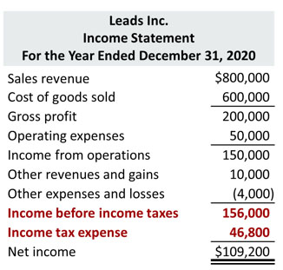
Income Statement Presentation (1 of 2)

Slide 72
Income Statement Presentation (2 of 2)
Companies record income tax expense and the related liability for income taxes payable as part of the adjusting process.
Using the data for Leads Inc., in Illustration 14.18, the adjusting entry for income tax expense at December 31, 2020, is as follows.:
Income Tax Expense
46,800
Income Taxes Payable
(To record income taxes for 2020)
46,800

Slide 73
Income Statement Analysis (1 of 2)
  E P S and Preferred Dividends
  Indicates the net income earned by each share of outstanding common stock
  To illustrate, assume that Rally Inc. reports net income of $211,000 on its 102,500 weighted-average common shares. During the year, it also declares a $6,000 dividend on its preferred stock. Therefore, the amount Rally has available for common stock dividends is $205,000 ($211,000 − $6,000). Earnings per share is calculated as follows.

Slide 74
Income Statement Analysis (2 of 2)
To illustrate, assume that Rally Inc. reports net income of $211,000 on its 102,500 weighted-average common shares. During the year, it also declares a $6,000 dividend on its preferred stock. Therefore, the amount Rally has available for common stock dividends is $205,000 ($211,000 − $6,000). Earnings per share is calculated as follows.

Slide 75
Do It! 3: E P S (1 of 3)
On January 1, 2020, Siena Corporation purchased 2,000 shares of treasury stock. Other information regarding Siena Corporation is provided below.
 | 2019 | 2020
Net income | $110,000 | $110,000
Dividends on preferred stock | 10,000 | 10,000
Dividends on common stock | 2,000 | 1,600
Weighted-average number of shares outstanding | 10,000 | 8,000*
Common stockholders’ equity, beginning of year | 500,000 | 400,000*
Common stockholders’ equity, ending of year | 500,000 | 400,000
*Adjusted for purchase of treasury stock.
(a) Compute earnings per share for each year, and (b) discuss the change from 2019 to 2020.

Slide 76
Do It! 3: E P S (2 of 3)
 | 2019 | 2020
Net income | $110,000 | $110,000
Dividends on preferred stock | 10,000 | 10,000
Dividends on common stock | 2,000 | 1,600
Weighted-average number of shares outstanding | 10,000 | 8,000*
Common stockholders’ equity, beginning of year | 500,000 | 400,000*
Common stockholders’ equity, ending of year | 500,000 | 400,000
*Adjusted for purchase of treasury stock.
(a) Compute earnings per share for each year.
2019
2020

Slide 77
Do It! 3: E P S (3 of 3)
(b) Discuss the change from 2019 to 2020.
Between 2019 and 2020, earnings per share increased from $10 to $12.50. While this would appear to be good news for the company’s common stockholders, this increase should be carefully evaluated. It is important to note that net income did not change during this period. The increase was due to the purchase of treasury shares, which reduced the denominator of the ratio. As the company repurchases its own shares, it becomes more reliant on debt and thus increases its risk.

Slide 78
A Look at I F R S (3 of 5)
Key Points
Differences
There are often terminology differences for equity accounts.
G A A P | I F R S
Common stock | Share capital—ordinary
Stockholders | Shareholders
Par value | Nominal or face value
Authorized stock | Authorized share capital
Preferred stock | Share capital—preference
Paid-in capital | Issued/allocated share capital
Paid-in capital in excess of par—common stock | Share premium—ordinary
Paid-in capital in excess of par—preferred stock | Share premium—preference
Retained earnings | Retained earnings or Retained profits
Retained earnings deficit | Accumulated losses
Accumulated other comprehensive income | General reserve and other reserve accounts

Slide 79
Copyright
Copyright © 2018 John Wiley & Sons, Inc.
All rights reserved. Reproduction or translation of this work beyond that permitted in Section 117 of the 1976 United States Act without the express written permission of the copyright owner is unlawful. Request for further information should be addressed to the Permissions Department, John Wiley & Sons, Inc. The purchaser may make back-up copies for his/her own use only and not for distribution or resale. The Publisher assumes no responsibility for errors, omissions, or damages, caused by the use of these programs or from the use of the information contained herein.

